Slide 1
WindTrue: sensitivity analysis
Benjamin Sanderse
Prashant Kumar

Slide 2
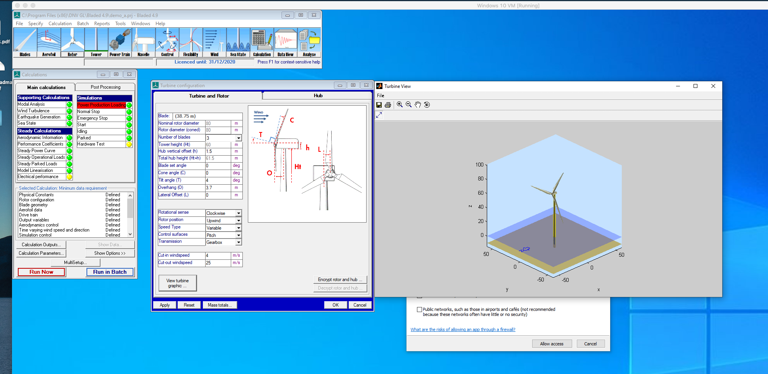
BEM Tools installed

Slide 3
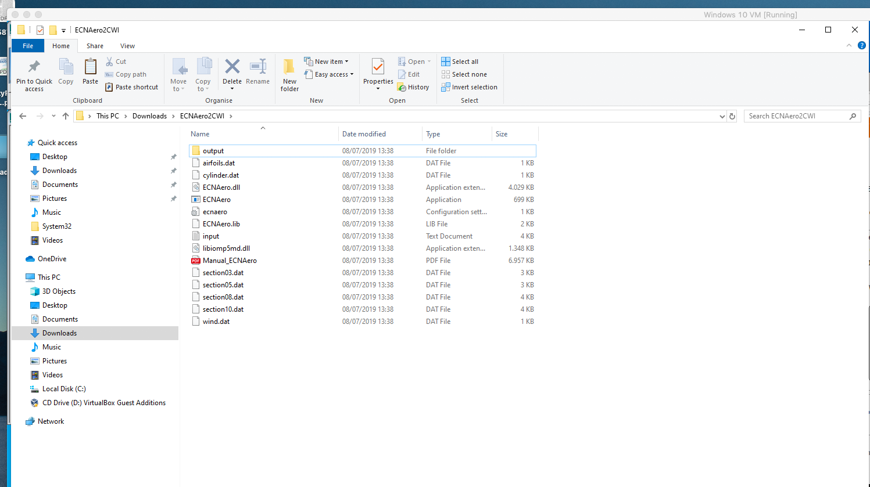
BEM Tools installed

Slide 4
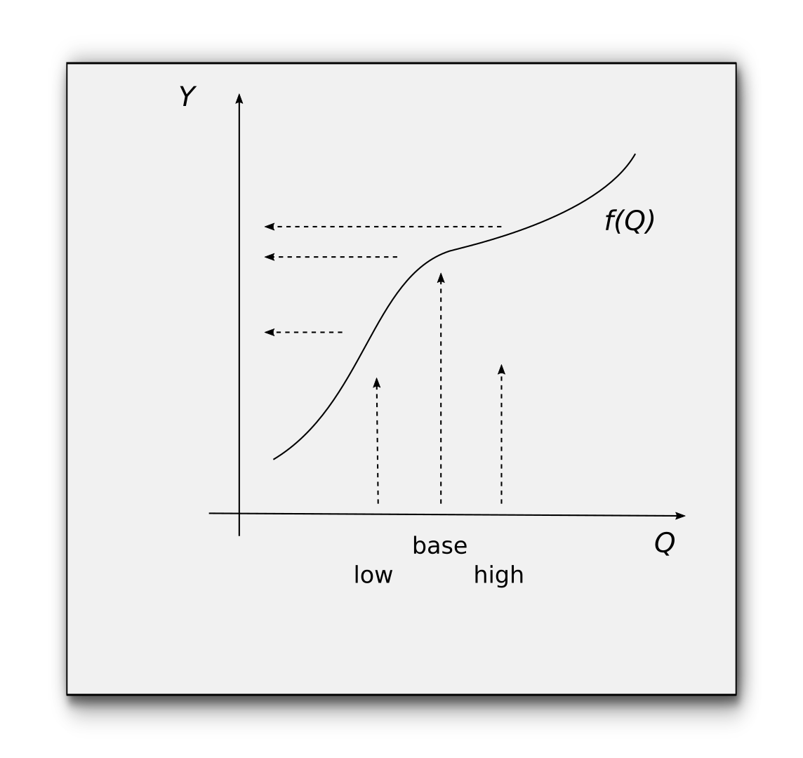
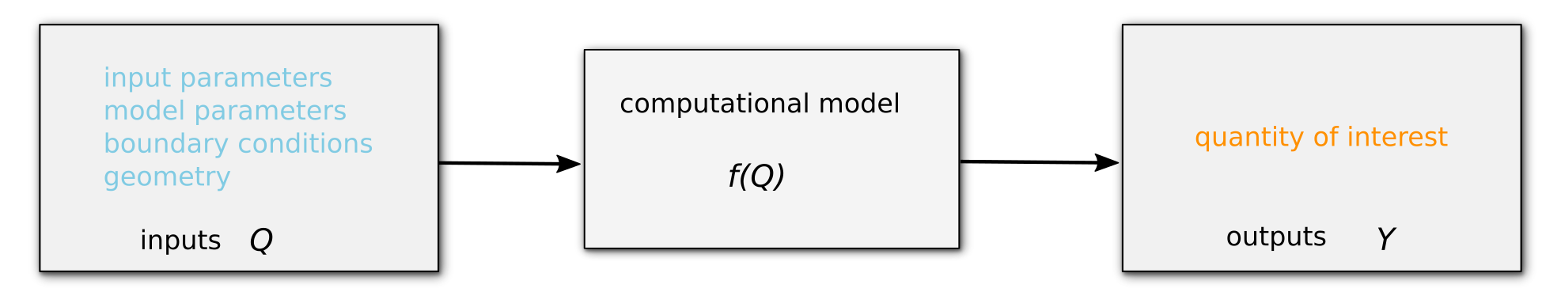
Propagation
Power
Fatigue loads
Moments
…
Inflow conditions
BEM parameters
Blade geometry
...

Slide 5
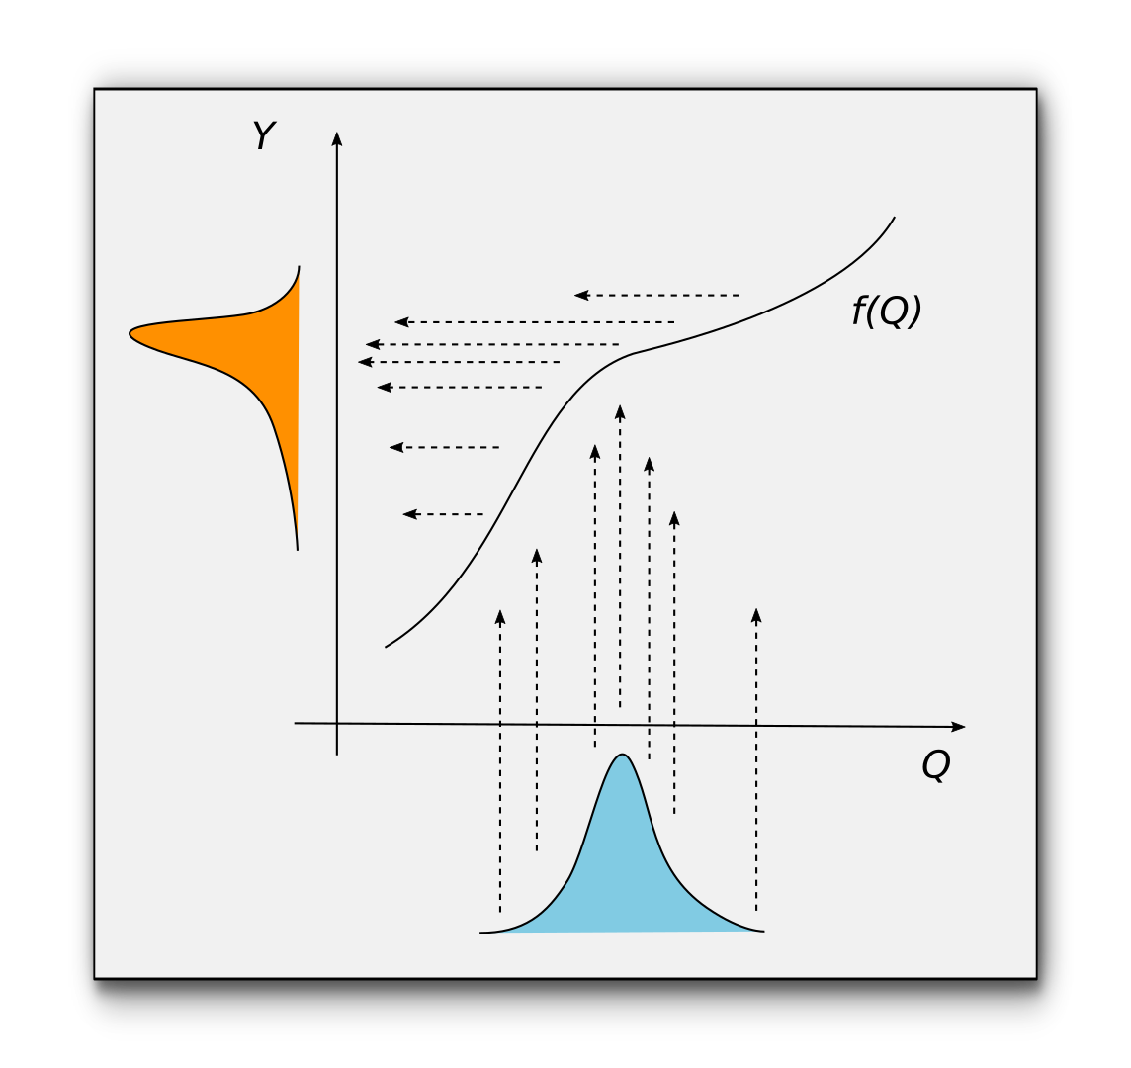
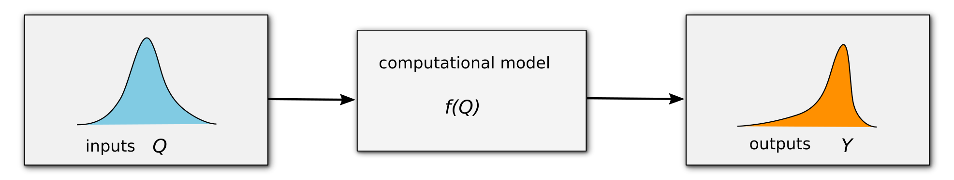
Propagation

Slide 6
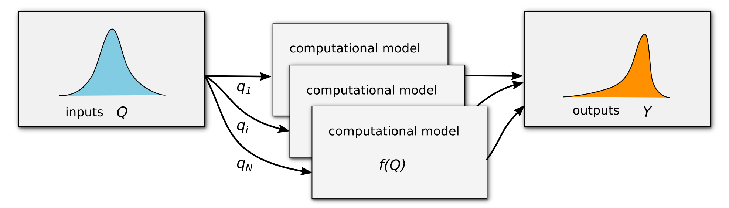
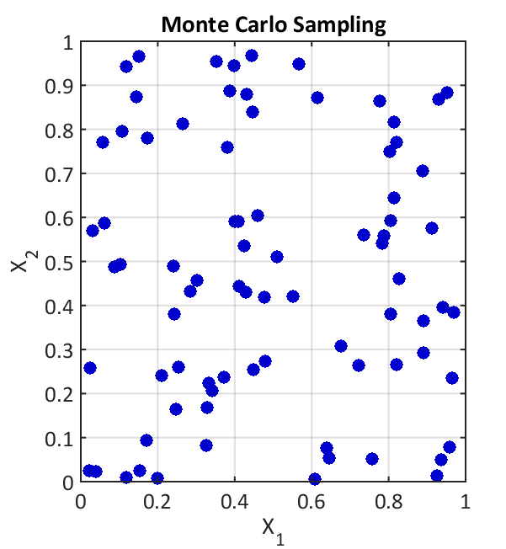
Monte Carlo
random samples q_{i}
with equal weights
slow convergence

Slide 7
Monte Carlo?
Challenge:
Fluid dynamic models feature very expensive models f(Q)
Approach:
Approximate full model with surrogate models

Slide 8
Surrogate models
Full model response
Response surface
Polynomials
Radial basis functions
Gaussian processes
Neural networks

Slide 9
Polynomial response surface
Polynomial expansion (PCE)
Fourier expansion in random space:
Use polynomials orthogonal with respect to PDF :

Slide 10
Polynomial Chaos Expansion
Orthogonality example
Gaussian random variable
Hermite polynomials

Slide 11
Polynomial Chaos Expansion
Fourier expansion in random space:
Coefficients follow from
Approximate with quadrature rules
Model sampling at nodes q_{k} and weights w_{k}

Slide 12
Polynomial Chaos Expansion
deterministic samples q_{i}
‘smart’ weights w_{i}
analytic output

Slide 13
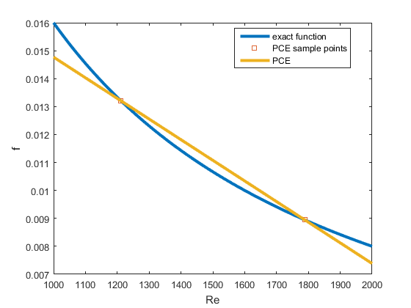
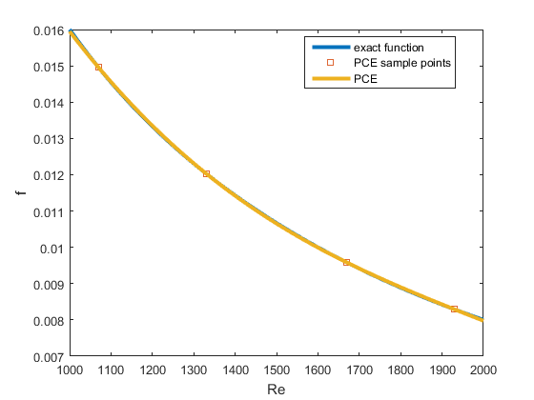
Polynomial Chaos Expansion
Example: function approximation (1D)
2 samples
4 samples

Slide 14
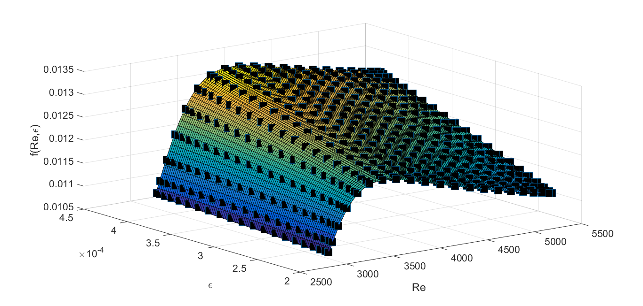
Polynomial Chaos Expansion
Example: function approximation (2D)

Slide 15
Choosing nodes
The art for constructing accurate surrogate models
Accuracy and stability
Nesting
Weighting with pdf
Chebyshev
Uniform
Gauss

Slide 16
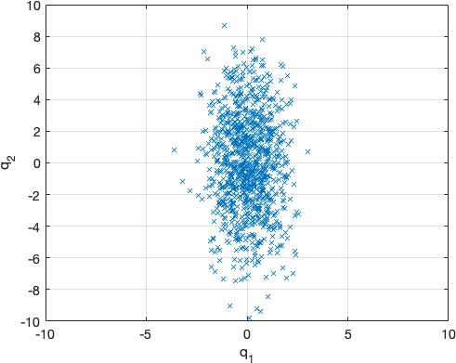
Sensitivity analysis
Input distribution represented by random samples

Slide 17
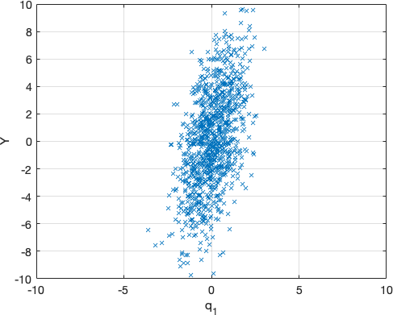
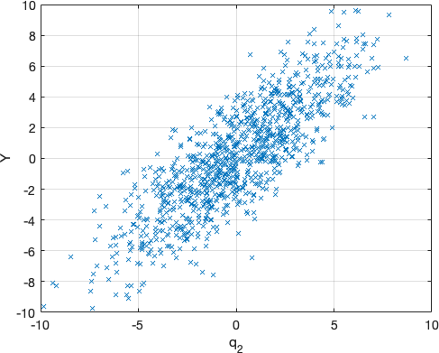
Sensitivity analysis
Output distribution depends on both c and sigma

Slide 18
Sensitivity analysis
Local sensitivity analysis:
Does not reflect uncertainty in Q well
Depends on point of evaluation (for non-linear models)

Slide 19

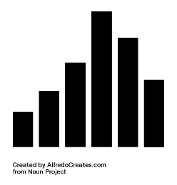
Sensitivity analysis
Global sensitivity analysis
Decompose variance of output in terms of variance of inputs
Sobol’ indices, first order:

Slide 20
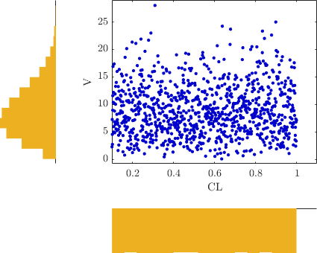
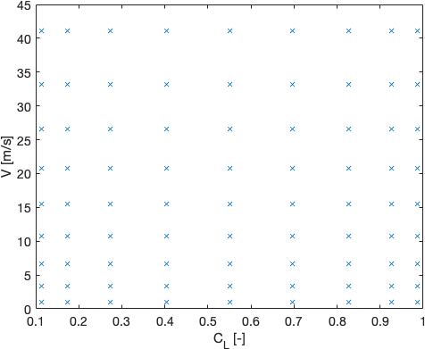
Sensitivity analysis
Example: airfoil lift
Input distributions
Experimental design for PCE

Slide 21
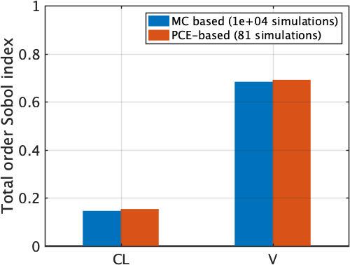
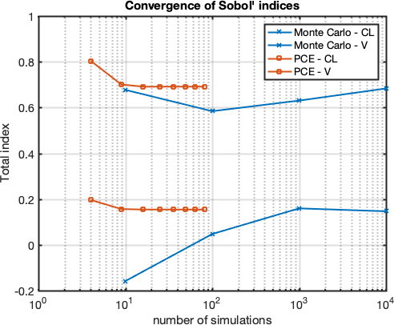
Sensitivity analysis
Example: airfoil lift
Total order Sobol’ indices
Convergence

